Slide 1


Statistiques avec
M2 Sciences du Langage
Remi.lafitte@univ-grenoble-alpes.fr
2023-2024

Slide 2

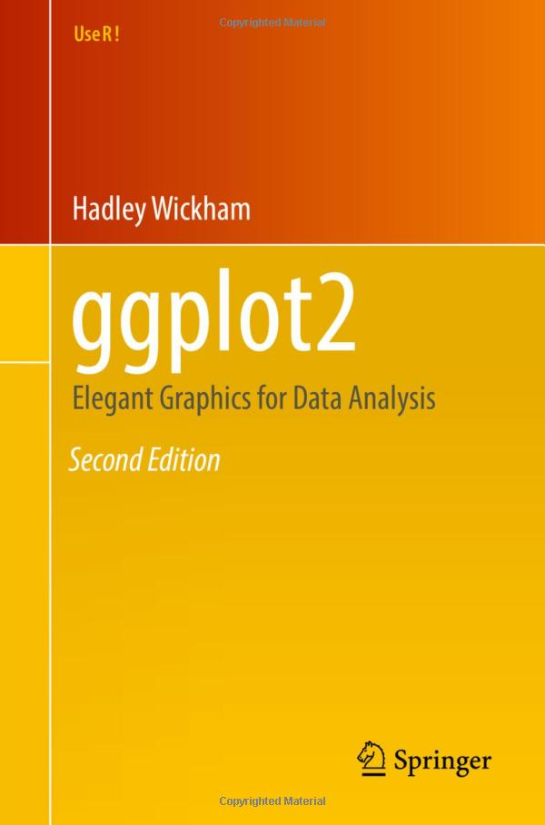
Ressources utiles
https://r4ds.had.co.nz/
https://ggplot2-book.org/

Slide 3
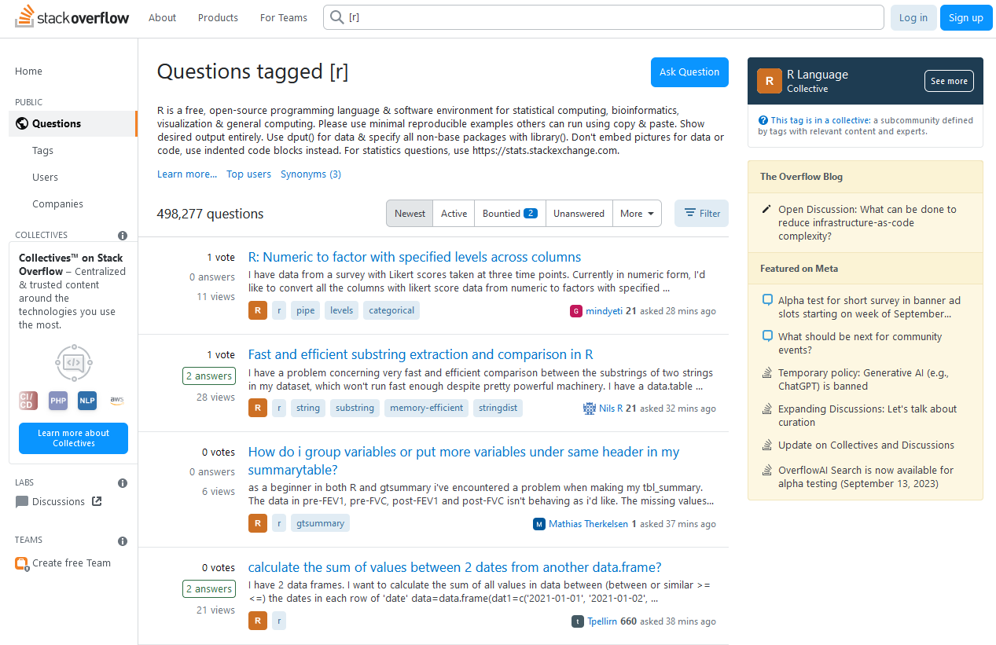
Ressources utiles
https://stackoverflow.com/questions/tagged/r

Slide 4
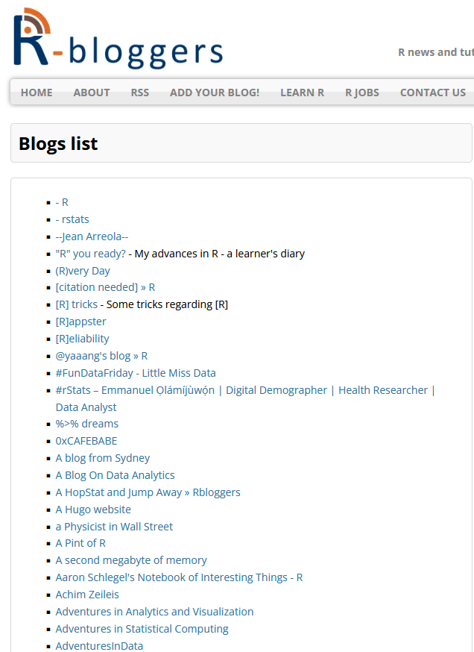
Ressources utiles
Liste de blogs :
https://www.r-bloggers.com/blogs-list/
https://www.r-bloggers.com/
https://www.datanovia.com/en/
https://rcompanion.org/handbook/
https://r-graph-gallery.com/ggplot2-package.html

Slide 5
Plan approximatif des TDs
TD1 27/10 - Bases de R
TD2 17/11 - Statistiques descriptives
TD3 17/11 - Statistiques descriptives
TD4 24/11 - Statistiques inférentielles
TD5 01/12 - Statistiques inférentielles
TD6 08/12 - Graphiques
TD6 15/12 - Rmarkdown

Slide 6
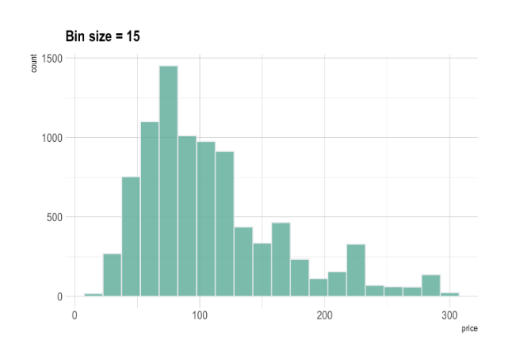
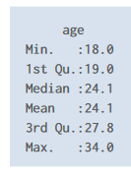
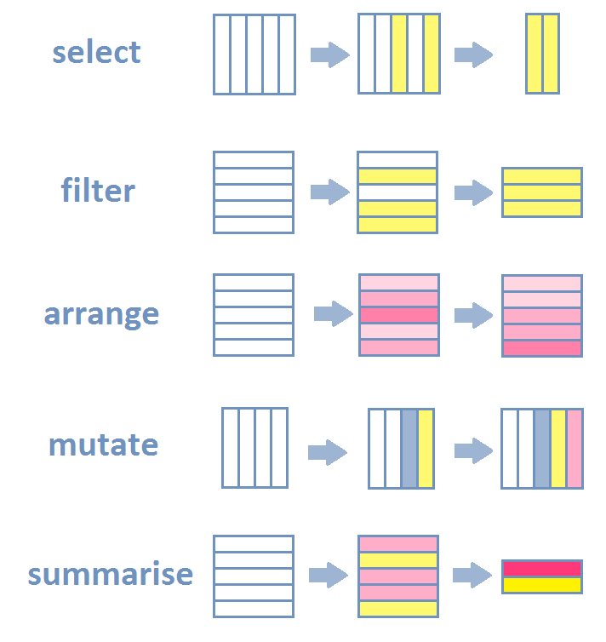
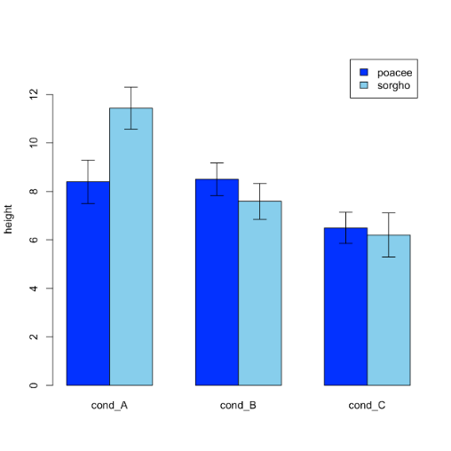
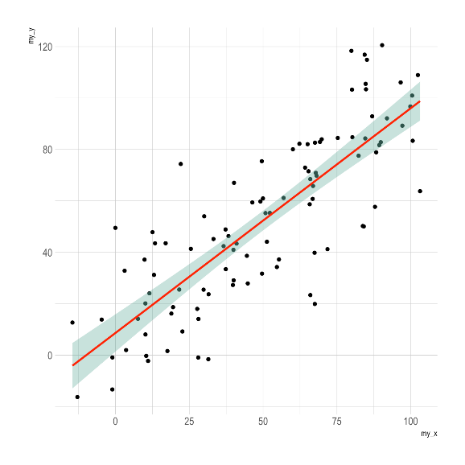
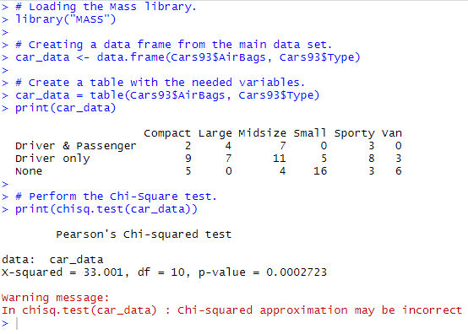
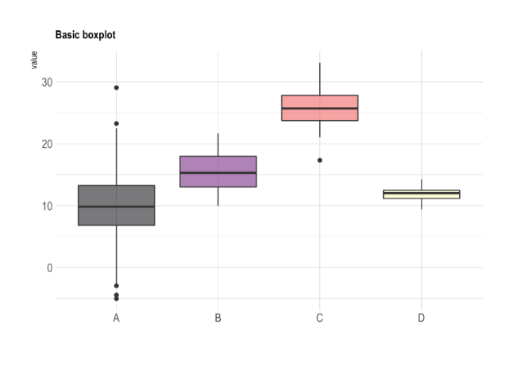
Pourquoi R ?
Langage « simple » et flexible
graphiques
statistiques
Manipulation des données

Slide 7
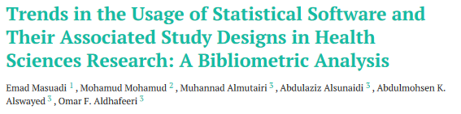
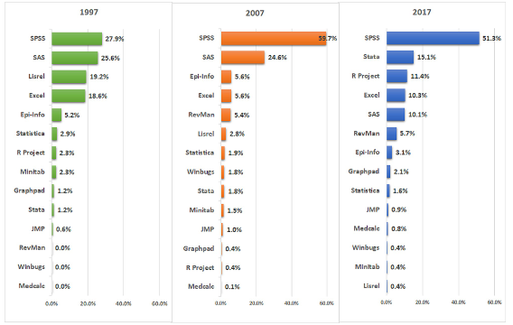
Pourquoi R ?
De plus en plus populaire

Slide 8
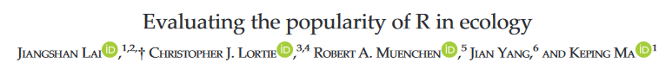
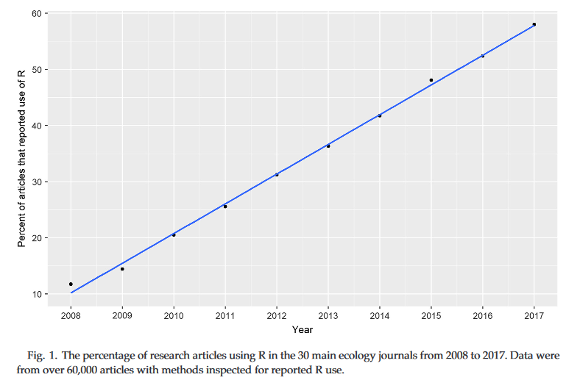
Pourquoi R ?
De plus en plus adopté par les scientifiques
https://scholar.google.com/scholar?hl=fr&as_sdt=0%2C5&as_ylo=2019&q=popularity+R+statistical+software&btnG=
https://www.ncbi.nlm.nih.gov/pmc/articles/PMC7872865/pdf/cureus-0013-00000012639.pdf
À peu près 11000 articles
https://www.ncbi.nlm.nih.gov/pmc/articles/PMC10090872/pdf/rsos.221550.pdf#bmk_RSOS221550C23
https://flowingdata.com/2016/03/22/comparing-ggplot2-and-r-base-graphics/

Slide 9

https://allisonhorst.com/r-slack-emoji

Slide 10
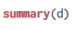


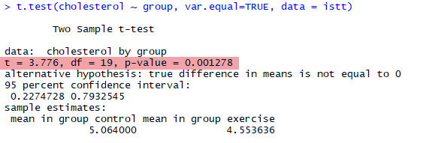

Pourquoi R ?
On peut presque tout faire avec R
Stat descriptives et inférentielles
Graphiques
Manipuler des jeux de données complexes
https://r-graph-gallery.com/
https://scholar.google.com/scholar?hl=fr&as_sdt=0%2C5&as_ylo=2019&q=popularity+R+statistical+software&btnG=
https://www.ncbi.nlm.nih.gov/pmc/articles/PMC7872865/pdf/cureus-0013-00000012639.pdf
À peu près 11000 articles
https://www.ncbi.nlm.nih.gov/pmc/articles/PMC10090872/pdf/rsos.221550.pdf#bmk_RSOS221550C23
https://flowingdata.com/2016/03/22/comparing-ggplot2-and-r-base-graphics/

Slide 11
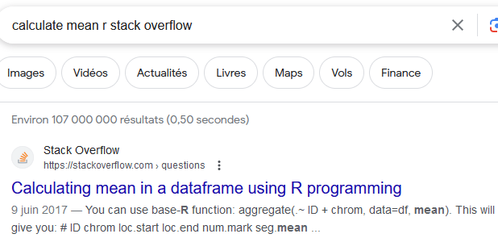

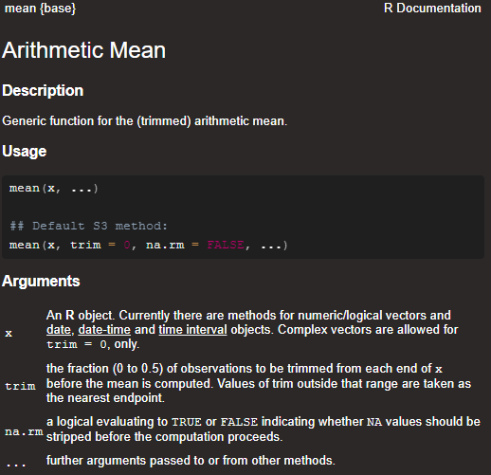

Pourquoi R ?
Large documentation
Stack overflow
Autres sites, blogs…
Livres…
Ce qui vous attend
LE classique
Documentation de qualité dans R
https://r4ds.hadley.nz/

Slide 12
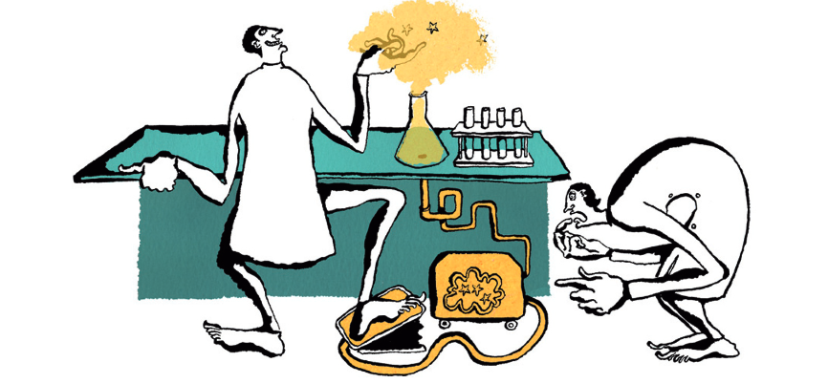
Pourquoi R ?
Reproductibilité computationnelle
“Reproducing the result of a computation means running the same software on the same input data and obtaining the same results” p.2
“Replicating a published result means writing and then running new software based on the description of a computational model or method provided in the original publication, and obtaining results that are similar enough to be considered equivalent” p.3
https://www.nature.com/articles/nj7396-137a
Rougier, N. P., Hinsen, K., Alexandre, F., Arildsen, T., Barba, L. A., Benureau, F. C. Y., et al. (2017). Sustainable Computational Science: The ReScience Initiative. Available online at: https://arxiv.org/abs/1707.04393
https://jamanetwork.com/journals/jama/fullarticle/2752474
The identified programming error […] occurred while the variable referring to the study “arm” (ie, group) assignment was recoded. The purpose of the recoding was to change the randomization assignment variable format of “1, 2” to a binary format of “0, 1.” However, the assignment was made incorrectly and resulted in a reversed coding of the study groups …
[…] As noted here, this reanalysis showed reversed study findings […]

Slide 13
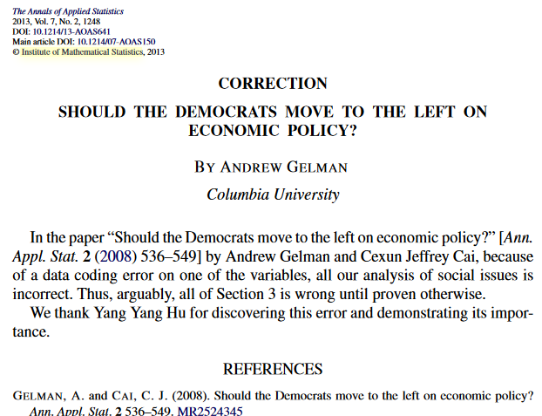
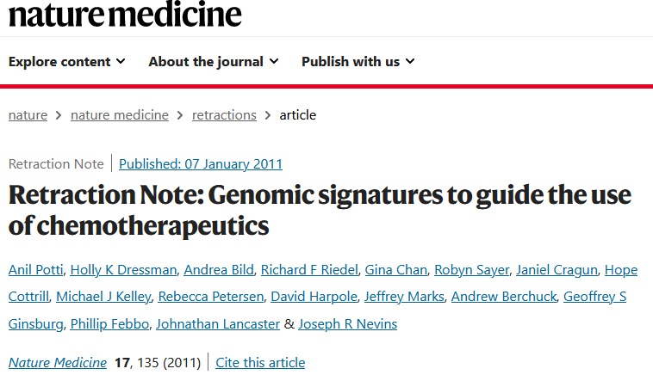
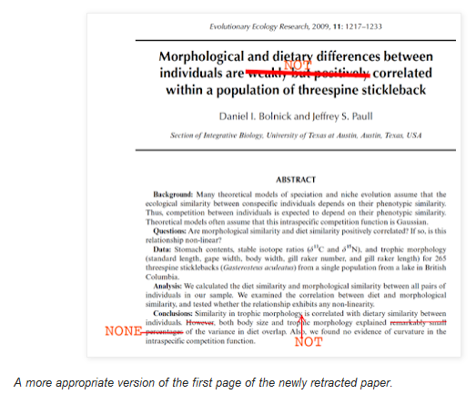
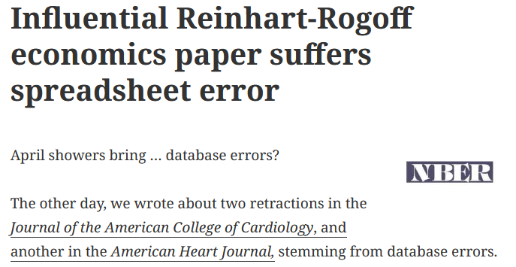
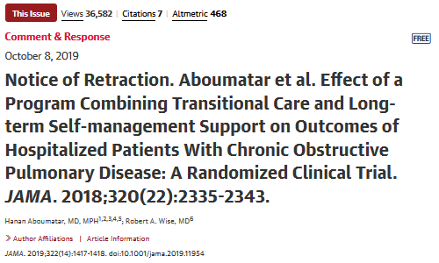
Pourquoi R ?
Reproductibilité computationnelle
Permet de repérer les erreurs
Corrections (ou rétractation) si besoin
Erreurs de codage
Erreurs dans jeu de données
Erreurs de stat
https://retractionwatch.com/2013/04/18/influential-reinhart-rogoff-economics-paper-suffers-database-error/
http://ecoevoevoeco.blogspot.com/2016/12/wrong-lot.html
https://jamanetwork.com/journals/jama/fullarticle/2752474
The identified programming error […] occurred while the variable referring to the study “arm” (ie, group) assignment was recoded. The purpose of the recoding was to change the randomization assignment variable format of “1, 2” to a binary format of “0, 1.” However, the assignment was made incorrectly and resulted in a reversed coding of the study groups …
[…] As noted here, this reanalysis showed reversed study findings […]

Slide 14


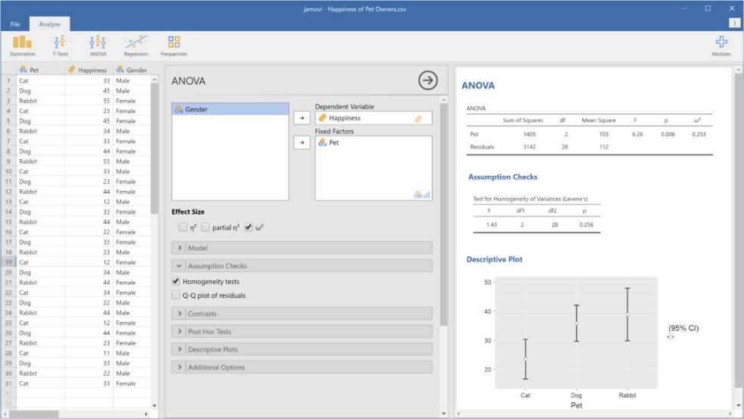
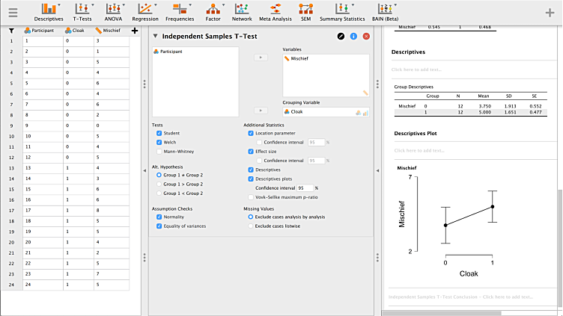
Pourquoi R ?
Gratuit
Alternatives gratuites mais « clic-bouton »
JAMOVI
JASP
Possibilité de sauvegarder la trace des opérations « clic-bouton » ! »
Compatible avec science ouverte
https://scholar.google.com/scholar?hl=fr&as_sdt=0%2C5&as_ylo=2019&q=popularity+R+statistical+software&btnG=
https://www.ncbi.nlm.nih.gov/pmc/articles/PMC7872865/pdf/cureus-0013-00000012639.pdf
À peu près 11000 articles
https://www.ncbi.nlm.nih.gov/pmc/articles/PMC10090872/pdf/rsos.221550.pdf#bmk_RSOS221550C23
https://flowingdata.com/2016/03/22/comparing-ggplot2-and-r-base-graphics/

Slide 15
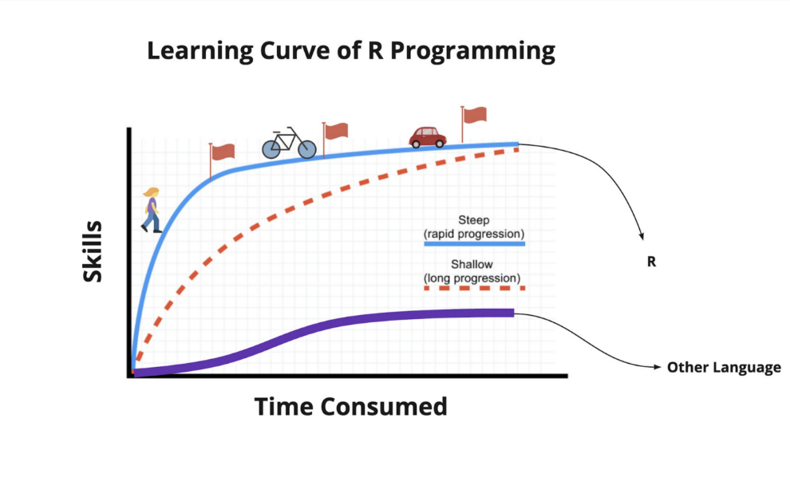
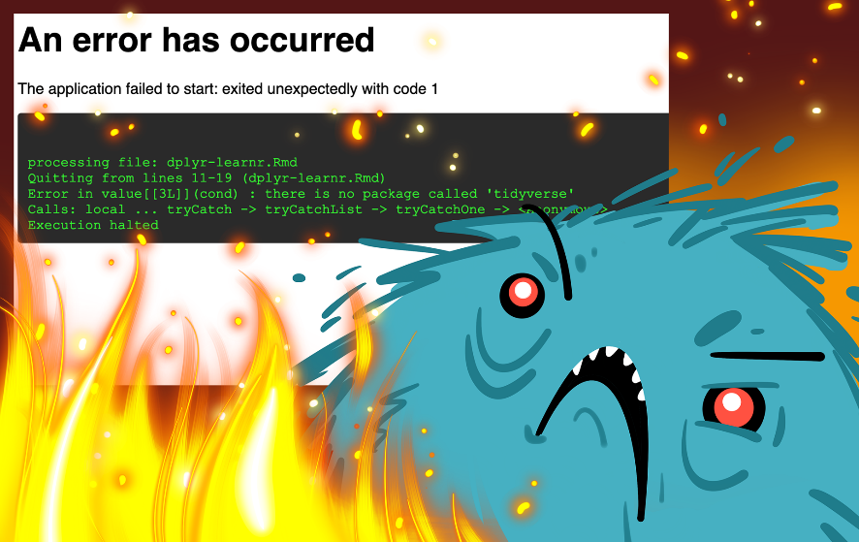
Pourquoi R ?
Avantages et inconvénients de R vs logiciels clic-bouton
 | R | JAMOVI/JASP | SPSS
Difficulté | +++ ? | + | +
Frustration | +++ | + | +?
https://slidemodel.com/templates/5-scale-emoji-feedback-powerpoint-template/
https://jamanetwork.com/journals/jama/fullarticle/2752474
The identified programming error […] occurred while the variable referring to the study “arm” (ie, group) assignment was recoded. The purpose of the recoding was to change the randomization assignment variable format of “1, 2” to a binary format of “0, 1.” However, the assignment was made incorrectly and resulted in a reversed coding of the study groups …
[…] As noted here, this reanalysis showed reversed study findings […]

Slide 16



Pourquoi R ?
Avantages et inconvénients de R vs logiciels clic-bouton
 | R | JAMOVI/JASP | SPSS
Science ouverte / reproductibilité | +++ | +++ | +
Prix | Gratuit | Gratuit | Payant
Champ des possibles | +++ | + | +?
Graphiques | +++ | ++ | +?
Documentation | +++ | ++ | +
https://slidemodel.com/templates/5-scale-emoji-feedback-powerpoint-template/
https://jamanetwork.com/journals/jama/fullarticle/2752474
The identified programming error […] occurred while the variable referring to the study “arm” (ie, group) assignment was recoded. The purpose of the recoding was to change the randomization assignment variable format of “1, 2” to a binary format of “0, 1.” However, the assignment was made incorrectly and resulted in a reversed coding of the study groups …
[…] As noted here, this reanalysis showed reversed study findings […]

Slide 17
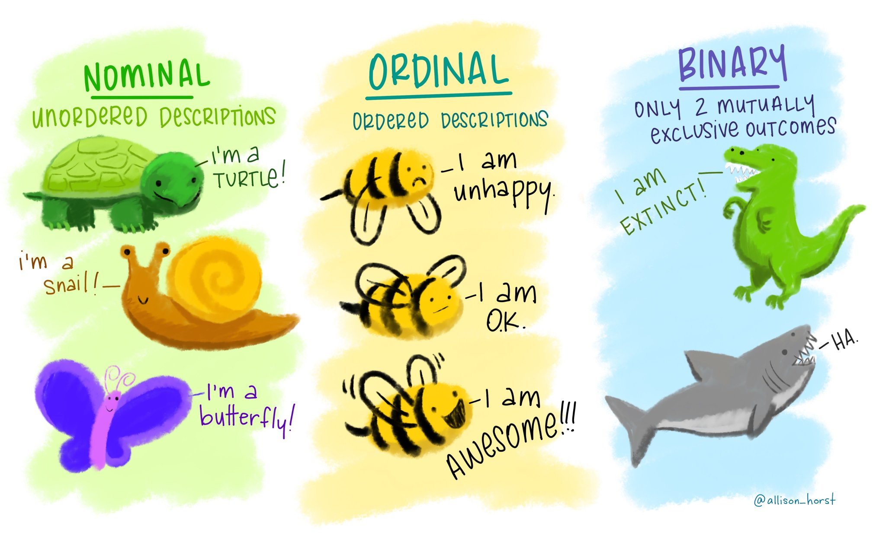
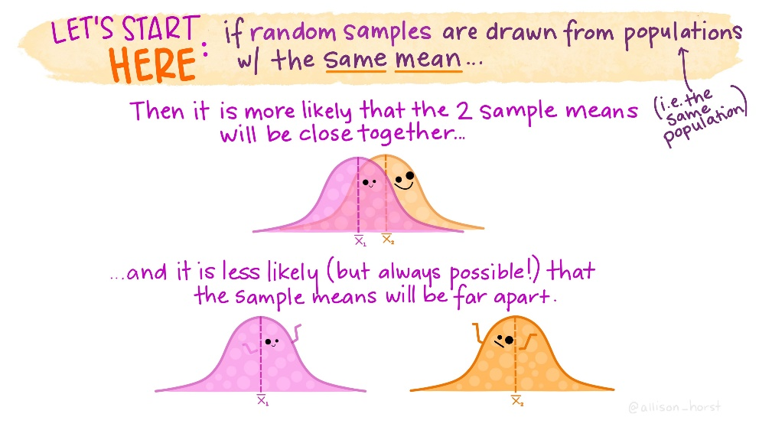
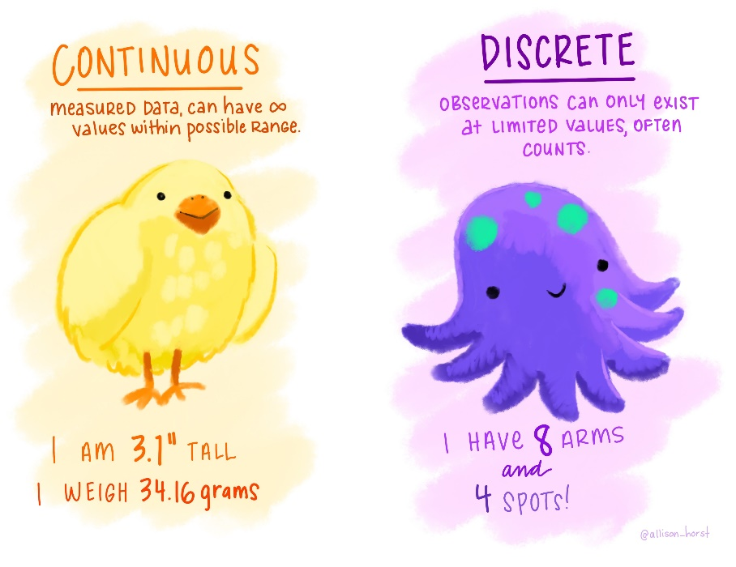
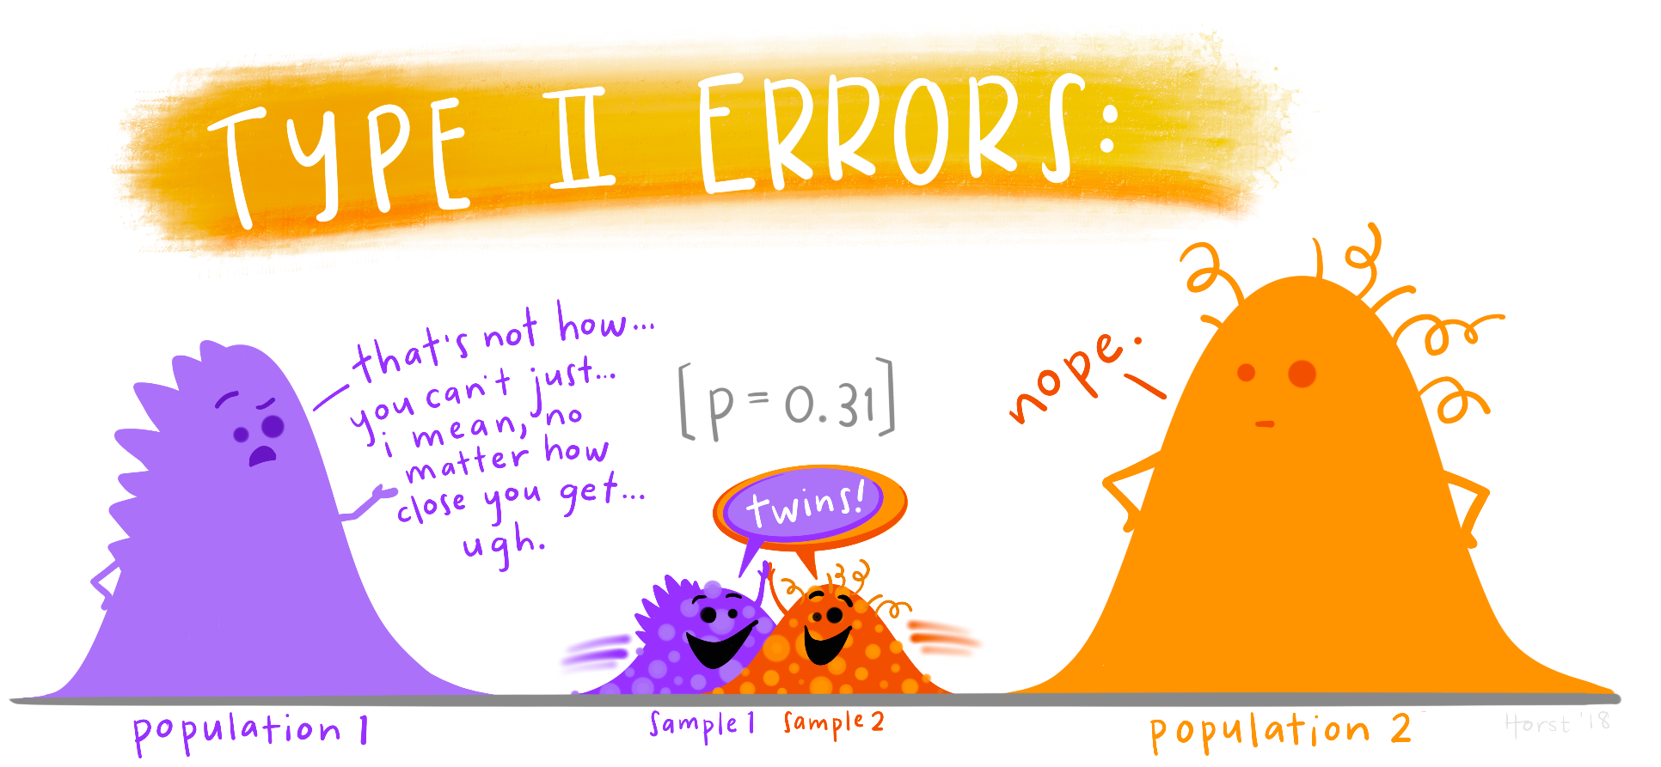
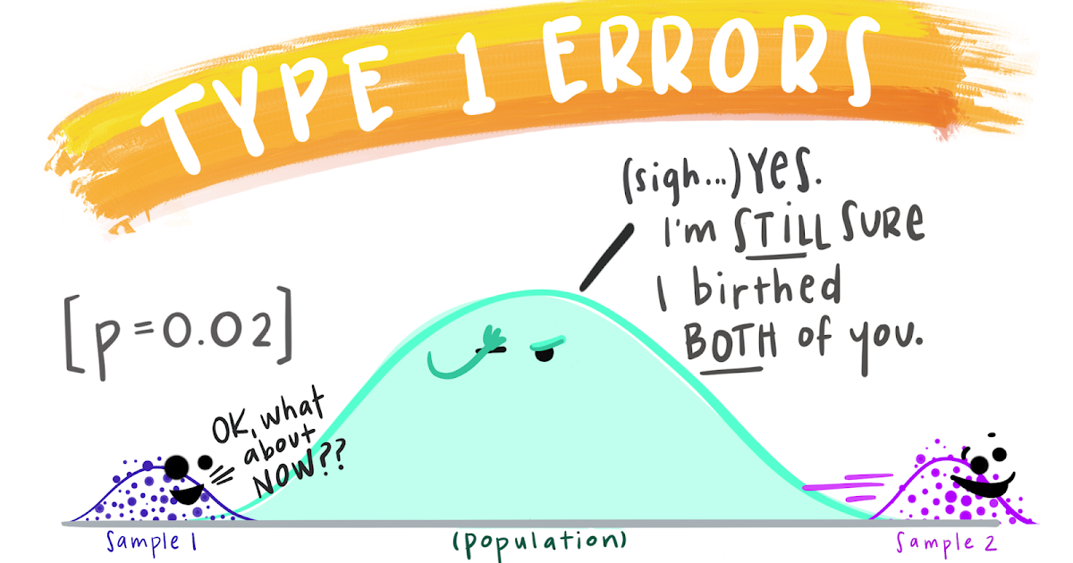
https://www.google.com/url?sa=i&url=https%3A%2F%2Fflowingdata.com%2F2022%2F10%2F24%2Feducational-statistics-illustrations%2F&psig=AOvVaw0VA0kaxQrM8W2DKyUTEM7G&ust=1694701705268000&source=images&cd=vfe&opi=89978449&ved=0CBAQjRxqFwoTCLi-5vnlp4EDFQAAAAAdAAAAABAT
https://www.google.com/url?sa=i&url=https%3A%2F%2Ftwitter.com%2Fallison_horst%2Fstatus%2F1216411207223009280&psig=AOvVaw1ntuCK61c2o0JgLcyruwKW&ust=1694701902714000&source=images&cd=vfe&opi=89978449&ved=0CBAQjRxqFwoTCMiL8dfmp4EDFQAAAAAdAAAAABAJ
https://www.google.com/url?sa=i&url=https%3A%2F%2Ftwitter.com%2Fallison_horst%2Fstatus%2F1317869593692569600&psig=AOvVaw1ntuCK61c2o0JgLcyruwKW&ust=1694701902714000&source=images&cd=vfe&opi=89978449&ved=0CBAQjRxqFwoTCMiL8dfmp4EDFQAAAAAdAAAAABAE
https://www.google.com/url?sa=i&url=https%3A%2F%2Ftwitter.com%2Fallison_horst%2Fstatus%2F1303929033604780032&psig=AOvVaw0VA0kaxQrM8W2DKyUTEM7G&ust=1694701705268000&source=images&cd=vfe&opi=89978449&ved=0CBAQjRxqFwoTCLi-5vnlp4EDFQAAAAAdAAAAABAb

Slide 18


TD 2 17/11/2023 Statistiques descriptives sur R
https://allisonhorst.com/r-slack-emoji

Slide 19
TD 3 24/11/2023 Statistiques inférentielles sur R (1)

